Slide 1

13th Annual COVADIS Summit
Tuesday 2nd September 2025
1. National Network Updates Janet Wei (USA), Chris Zeitz (AU)
0830 | Microvascular Network | Nathaniel Smilowitz (USA)
0837 | UK Microvascular Dysfunction Working Group | Colin Berry (UK)
0844 | Spanish Registry | Eva Rumiz (ES)
0851 | NetherLands Coronary vasomotor Function Testing (NL-CFT) Registry | Peter Damman (NL)
0858 | CMD Registries in Japan (J-CMD) and Worldwide (Inter-CMD) | Hiroaki Shimokawa (JP)
0905 | Italian Registry | Antonello Leone (IT)
0912 | CSANZ Coronary Vasomotor Dysfunction Working Group | Chris Zeitz (AU)
0919 | Canadian INOCA Physiology Working Group | Erick Schampaert (CA)
0926 | Czech Registry (CoroPhys-CZECH) | Petr Kala (CZ)
0934 | How can the National Networks and COVADIS collaborate? | Panel Discussion
1030 | Coffee Break
https://covadis.online/

Slide 2
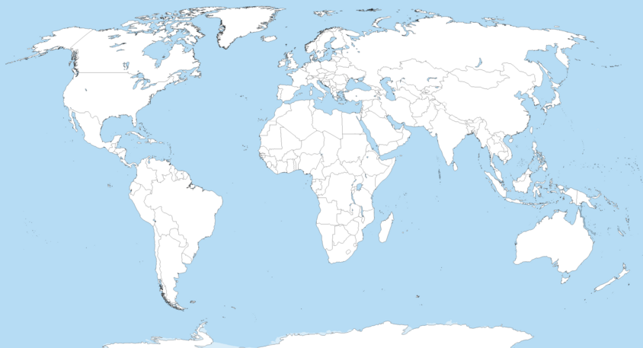
The Coronary Vasomotor National Networks
UK Microvascular
Dysfunction
Wk Gp
Canadian INOCA
Physiology Wk Gp
Netherlands Coronary Vasomotor
Function Testing Registry
Czech Registry
Microvascular
Network
Spanish
Registry
Italian
Registry
Japanese CMD
Registry
Cardiac Society of
Australia & New Zealand
Coronary Vasomotor
Dysfunction Wk Gp

Slide 3
Potential National Networks-COVADIS Collaborations
Functional Coronary Angiography
  Global Functional Coronary Angiogram Survey
  Functional Coronary Angiography Forum
  Universal Position Paper on Functional Coronary Angiography
COVADIS Website Resources
  National Network links
  Publications
Coronary Vasomotor Dysfunction Research Forum
  Virtual vs Post-major meeting
ANOCA / INOCA Clinical Trial Registry
  Facilitate patient recruitment

